Slide 1
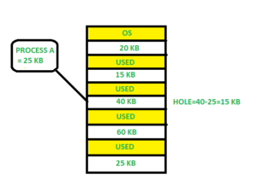
First Fit
In the first fit, the partition is allocated which is the first sufficient block from the top of Main Memory.
It scans memory from the beginning and chooses the first available block that is large enough. Thus it allocates the first hole that is large enough.

Slide 2
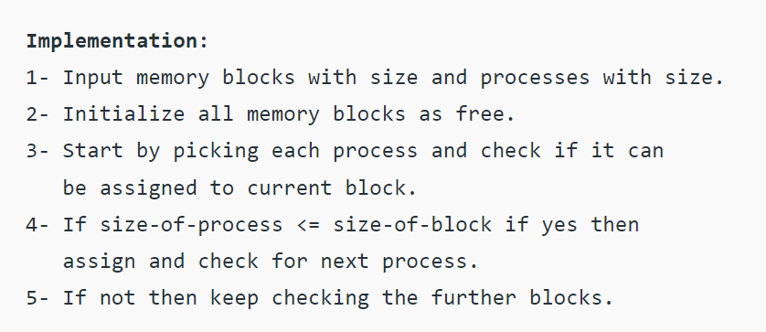

Slide 3
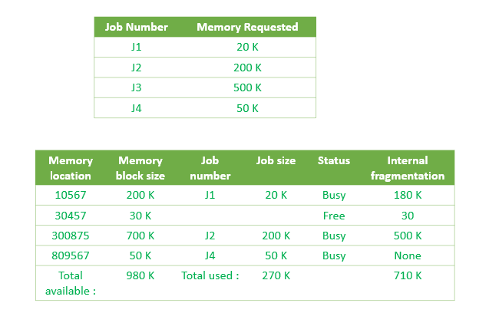
First Fit
External Fragmentation

Slide 4
First Fit
Advantage-
Its advantage is that it is the fastest search as it searches only the first block i.e. enough to assign a process.
Disdvantage-
It may have problems of not allowing processes to take space even if it was possible to allocate.

Slide 5
Best Fit
Allocate the process to the partition which is the first smallest sufficient partition among the free available partition.
It searches the entire list of holes to find the smallest hole whose size is greater than or equal to the size of the process.

Slide 6
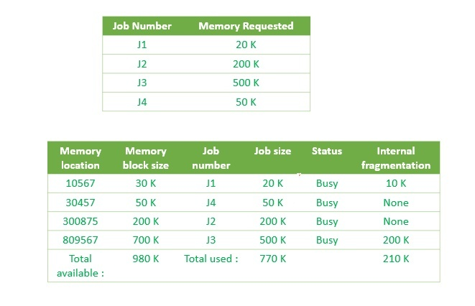
Best Fit

Slide 7
Best Fit
Advantages-
Improved memory utilization, as it allocates the smallest block of memory that is sufficient to accommodate the memory request from the process.
Additionally, Best-Fit can also help to reduce memory fragmentation, as it tends to allocate smaller blocks of memory that are less likely to become fragmented.
Disadvantages-
Additionally, Best-Fit may also result in increased fragmentation, as it may leave smaller blocks of memory scattered throughout the memory space.

Slide 8
Best Fit
This method keeps the free/busy list in order by size – smallest to largest.
In this method, the operating system first searches the whole of the memory according to the size of the given job and allocates it to the closest-fitting free partition in the memory,

Slide 9
Worst-Fit
In this allocation technique, the process traverses the whole memory and always search for the largest hole/partition, and then the process is placed in that hole/partition.
It is a slow process because it has to traverse the entire memory to search the largest hole.

Slide 10
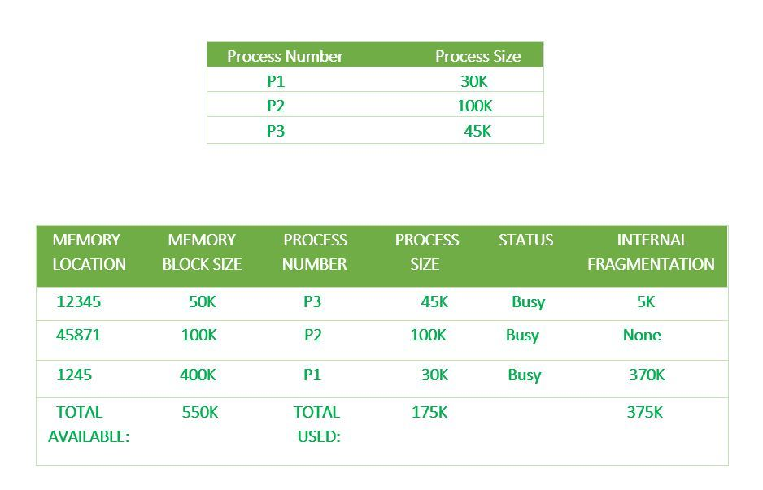
Worst-Fit

Slide 11
Exercise 1
Consider four memory partitions of size 300KB, 30KB, 650KB, 60KB. These partitions need to be allocated to the processes given below:-
Consider the Order for allocation to be taken as P1,P2,P3,P4 only. How will the allocation be done if First Fit, Best Fit, Worst Fit Allocation Methods are applied.
Process | Memory Required
P1 | 30KB
P2 | 250KB
P3 | 600KB
P4 | 50KB

